Slide 1


Industrializing your Data Science capabilities
Dubravko Dolic – Head of Applied Analytics and AI
Continental Tires

Slide 2
There and back again

Slide 3
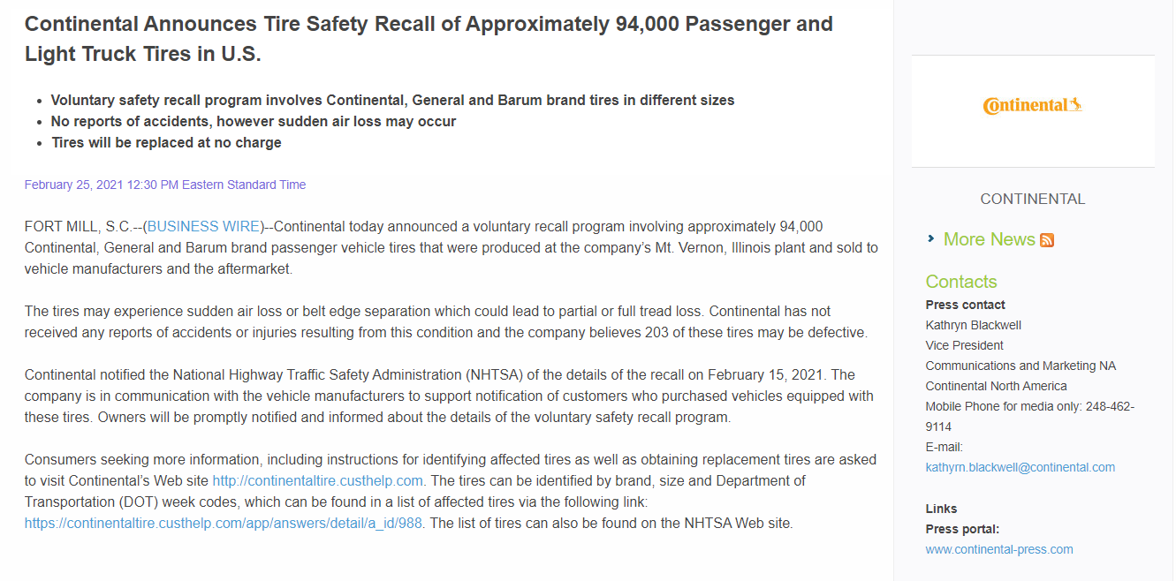
You may have heard about…if you‘re interested in tires

Slide 4
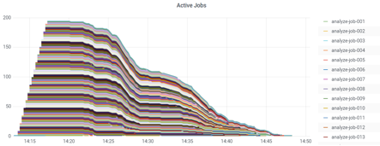
Technical Rollout on Data Science Factory
Deployment of algorithm to Data Science Factory: runtime of analysis: ~20 hours for all data (1-3 hours per year-production-hall combination, in total 8 combinations)
Jobs containerized on press level
Peak RAM Usage: ~600GB
Peak parallel jobs executed: 195
Time to rollout for generic process covering all relevant years: < 1 day
2017 example

Slide 5
Our first Use-Case: Predicting demand
Data extraction done by SQL
CSV files loaded to a local R installation
Visualizations in a PPT to convince business

Slide 6

Data Science Platform: Our first draft
Analytics Shop
Information Assets Overview
Solution / Model Repository
Administration
Lab
Factory
Analytics
Workbench
Data Science Laboratory
Data Product Development
Data Product Operations
Flexible tools
Explore data
Reports &
dashboards
Share use cases
Explain use cases
Use cases
experiments
Blueprints
(best practice)
Data ingest & prepare
Train predictive models
Complete
Data Products
Quality standards
Run analytics solutions
Improve Data Products
Monitor and
assure uptime
Data Access
& Provisioning
Connections to data sources (internal & external data)
Data ingestion and storage
Infrastructure
& Environments
Host Data Products in cloud or on premise
Provide satellites for the Data Science Laboratory

Slide 7

Components of cloud native architectures
Share
Collaborate on your projects by share and version you code
git
Project specific architecture
Integrate
Dockerize your application
Docker container
Deploy
Bring your code to the machine and integrate your application with CD/CI
Jenkins
Solution
Operate
Run your application and scale it with many other applications to the needs.
Kubernetes

Slide 8



Running down the DevOps road
Waterfall
Milestone
Milestone
Milestone
Milestone
highlighting change
rethink processes
spread decisions to the right
gain flexibility
accelerate delivery
Design
Implement
Test
Deploy
Operate
time of increment: 3 – 9 months
Sprint
Handover
Handover
Handover
…
Sprint
Sprint
Agile
Design, Implement, Test, Deploy, etc.
Design, Implement, Test, Deploy, etc.
Design, Implement, Test, Deploy, etc.
…....
Operate
Operate
Operate
highlighting ownership
rethink roles
spread operation to the left
gain responsiveness
accelerate time-to-market
time of increment: 2 – 6 weeks
Sprint
Sprint
Continous
delivery
Sprint
Plan
Plan
Plan
…....
Implement
Implement
Implement
Test
Test
Test
Release
Release
Release
Complexity
Deploy
Deploy
Deploy
Operate
Operate
Operate
Monitor
Monitor
Monitor
time of increment: hours to days

Slide 9






Usecase definition (canvas)
Identification of data sources
Preparation of development environment
Targetgroup/User
Solution
Ressources
Clarification with relevant IT
Obtain access credentials and define rules for access
Database access or static extract of data
Evaluation of data dictionaries and descriptions
Copy data to datalake or work locally
Generate virtual project environment (e.g., Miniconda)
Create git repository on https://github.conti.de
Business value for the customer
Business value for the company
TOP Features
Analytical Questions
Tasks
Phase I: Preparation
Description of problem
KPI for measuring the success (SMART)
Data to be used
Value and goals
Solution
Approach
Development in IDE
Industrialization/Containerization
Industrialization Checklist (Beta)
Data processing and management
Exploratory data analysis / descriptive statistics / visualization
Feature engineering
Model design
Model evaluation
Update virtual project environment
Documentation
Development on git branches other than master
Push deployable versions to master
Designated project name in DSF
Name your operating system
List of project-specific software installed on OS (e.g., drivers)
List of installed language packages (e.g. Python libraries) required in project, incl. version number
Definition of other artefacts (e.g., databases)
Definition of project execution specifics (e.g., scheduling)
Definition of pipeline
Requested version pushed to master
-> Open Ticket to IT Tires MLOps via EMail/Confluence/HPSM
Create project in Data Science Factory (DSF)
Build Dockerfile
Build Jenkinsfile
Define DSF Job config
Create resources (also for artifacts)
Implement Pipeline
Deploy project on DSF
Make service addresses available
Complete ticket
Phase 2: Development
iterative
Responsibilities: Data Scientist (DS) Business Partner (BP) IT Key User (KU) MLOps (ML)

Slide 10
Phase 3: Operation in DSF stages

Slide 11
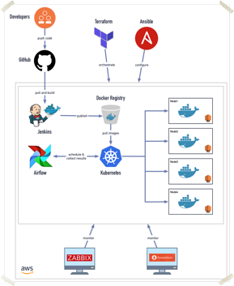

Data Science Platform: technical components
The DSF platform is running on the AWS infrastructure. Setup, provisioning and configuration of all required resources are driven by code (IaC). This approach enables automated provisioning and reduces administration costs considerably.
ELK

Slide 12
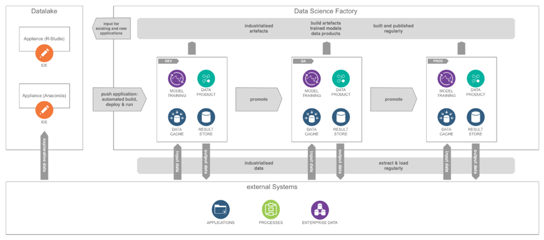
Data Science Platform: Workflow

Slide 13
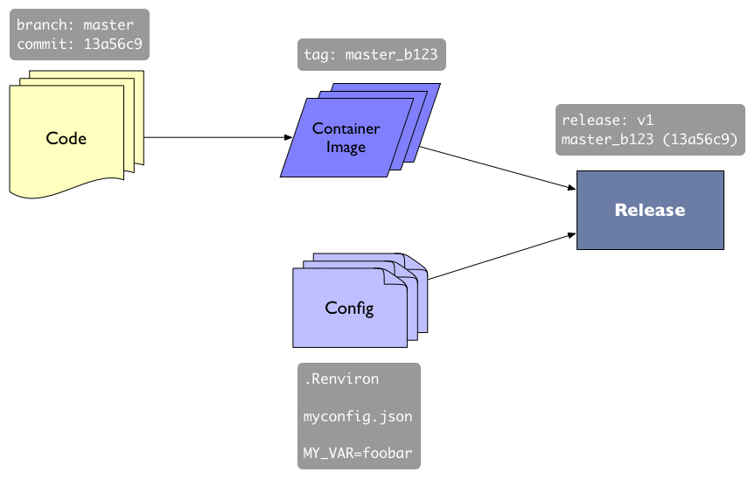

Slide 14
Deployment process

Slide 15
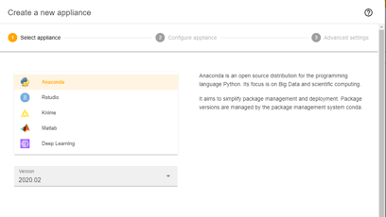
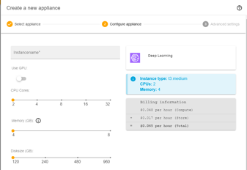
Intuitive User Interface for Data Scientists
Creating ready-to-use working environments for a number of templates
Root access
EC2-based
R-Studio
Jupyter Notebook
Python
KNIME, MATLAB

Slide 16
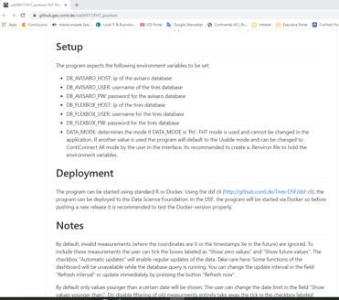
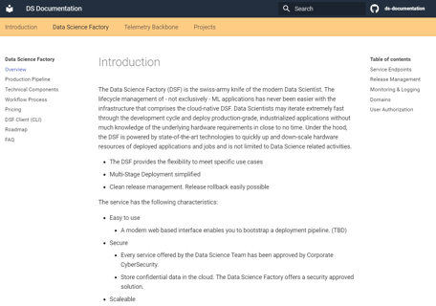
Git as central respository

Slide 17
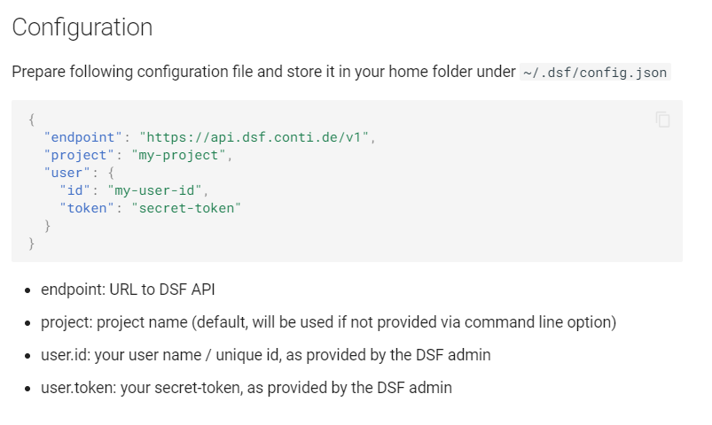
Central configuration for DSF projects

Slide 18
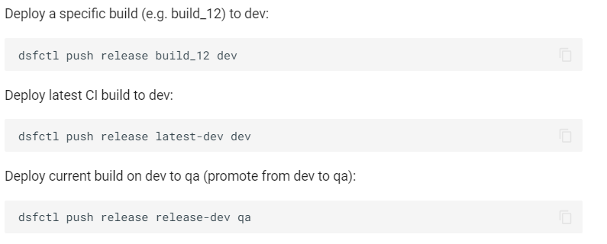
Deploy your version using DSF

Slide 19
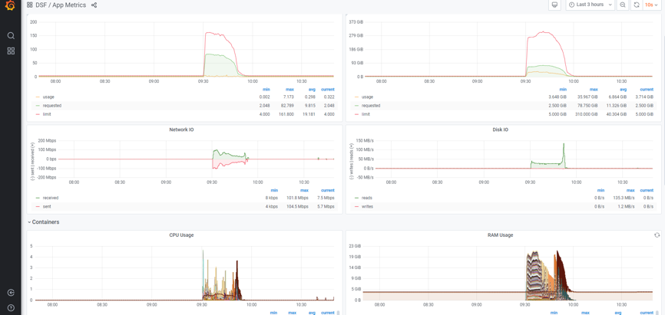
Monitoring

Slide 20
Advanced Analytics & AI Technology Stack

Slide 21
AWS SageMaker vs DSF
Workflow integration:
In SageMaker, DataScience and MLOps tasks are highly integrated
DSF offers a clearer division
With the current state of knowledge in the organization, the clear division of DSF is likely preferable
Workflow complexity:
The complexity a Data Scientist is exposed to is HIGHER in SageMaker than in the DSF
More complex as more services need to be known by Data Scientists
Data Science projects will overall not get easier because of SageMaker
In DSF due to clear division many MLOps components are transparent to the Data Scientist
The workload for MLOps seems to be similar in both infrastructures (needs to be reviewed)
SageMaker offers many solutions to many problems, choosing the right way may need additional expert knowledge currently not available in the organization

Slide 22
Where are we?
Business driven tools
Alteryx, Dataiku, KNIME
Data Science driven tools
Data Science Factory
IT driven tools
AWS, Google, Azure

Slide 23
Usecases

Slide 24
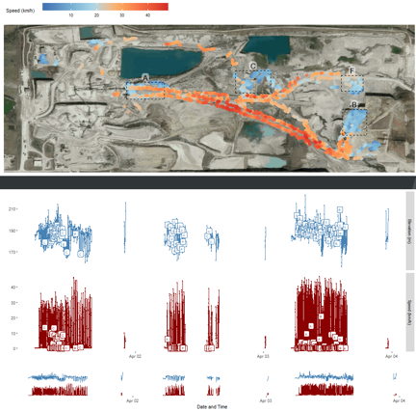
Tire sensor data
Predictive Maintenance
Monitoring
Speed
Elevation
Pressure
Predict harmful driving behaviour for specialty tires

Slide 25
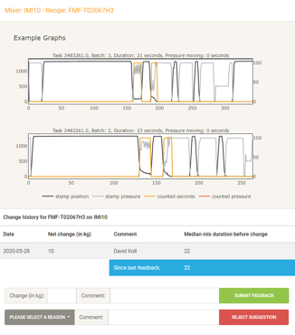
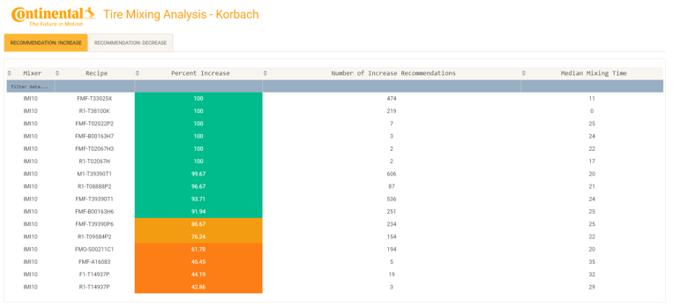
Mixing Analysis

Slide 26
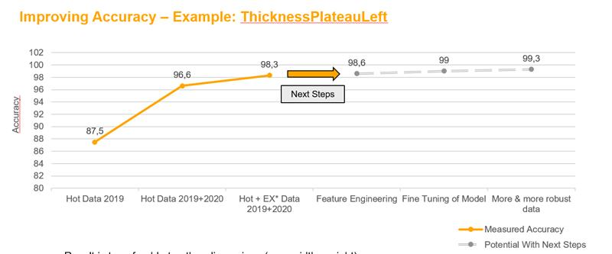
Extrusion: iterative optimizing of scrap prediction

Slide 27
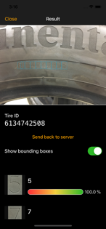
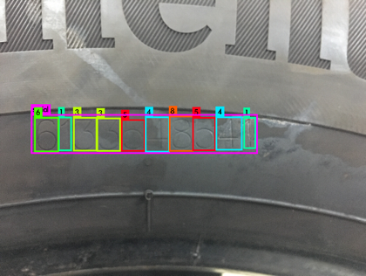
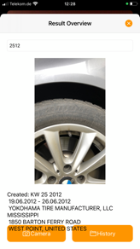
Tyre ID recognition
Extract serial numbers from images with OpenCV and YOLO

Slide 28

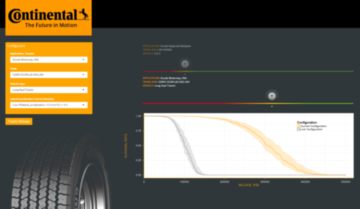
Predictive Maintainance as Service for Fleet Manager
Raw data
Data cleansing & processing
Tire status
Predictive Maintainance

Slide 29
Thanks for listening

